Slide 1

Running Large Language Models (LLMs) Locally
Empowering AI development. Explore benefits and implementation. localLearn to run LLMs on your own machine!
Ramya Chowdary Patchala
Tanu Rana
Karan Shah
Revanth Shahukaru

Slide 2
Large Language Models
What are LLMs?
Powerful AI, massive datasets.
Human-like Text
Generate text, answer questions.
Language Tasks
Versatile tools for various tasks.

Slide 3
Traditional LLMs vs. Local Alternatives
Cloud-Based LLMs
Local LLMs
OpenAI APIs (e.g., GPT)
Llama, Mistral, Gemma
Powerful, always updated
On your machine
Costly, privacy issues
Cost-effective, privacy
Requires internet access
Offline access possible

Slide 4
Streamlit/Codespaces
Local LLM Deployment
Quick Prototyping
Direct Hardware Access
Fast to create interactive apps with a UI.
Leverages your machine’s full CPU/GPU capabilities for faster performance.
Easy Setup
No Cloud Dependency
Codespaces provide a pre-configured, ready-to-use environment.
Works without internet, ensuring offline access and no latency issues.
Collaborative
Greater Privacy
Codespaces makes it easy for multiple people to work together.
Data stays local, reducing privacy concerns related to cloud storage.
Network Dependent
Complex Initial Setup
Requires a stable internet connection, which adds latency.
Requires managing dependencies and configuration on your own machine.

Slide 5
Local LLM Setup & Platforms
1
Choose an LLM
Llama, Mistral, or others.
2
Select a Platform
GPT4All, Ollama, etc.
3
Download & Setup
Follow platform instructions.
4
Interact with Model
Use local interface.
GPT4All
Ollama
Easy-to-use interface.
Model management system.
LMStudio
H2O GPT
Advanced features.
Open-source option.

Slide 6
GPT4All
GPT4All is an open-source project enabling local deployment of LLMs.
Focuses on user-friendly setup for offline use.
Supports various models like GPT-J, LLaMa-based architectures.
Example Use: Run NLP applications without API costs.
Notes:
GPT for all target users Developers, hobbiyists

Slide 7
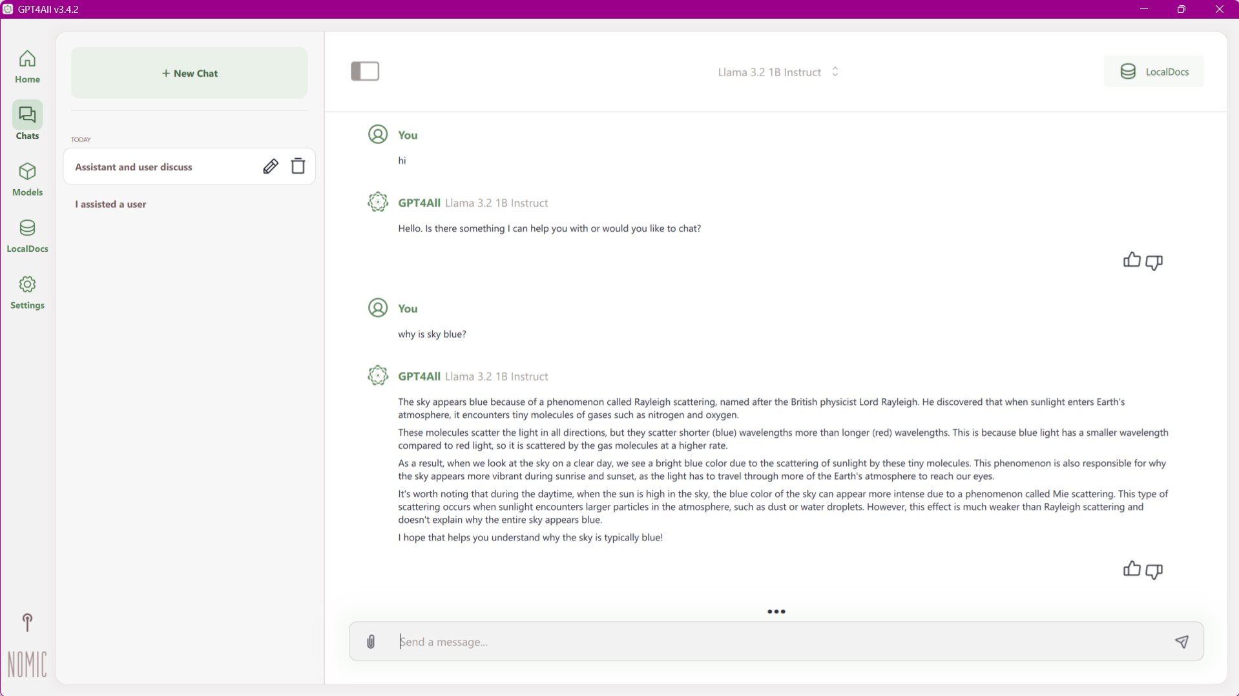
Download from : https://www.nomic.ai/gpt4all

Slide 8
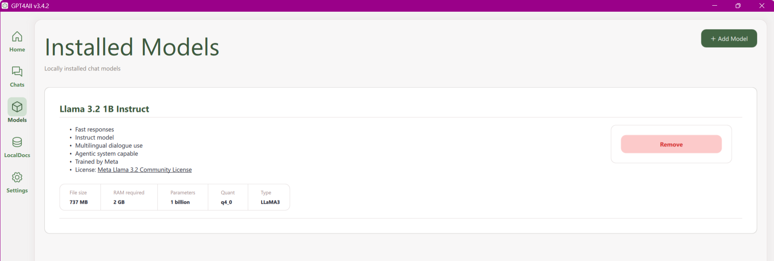
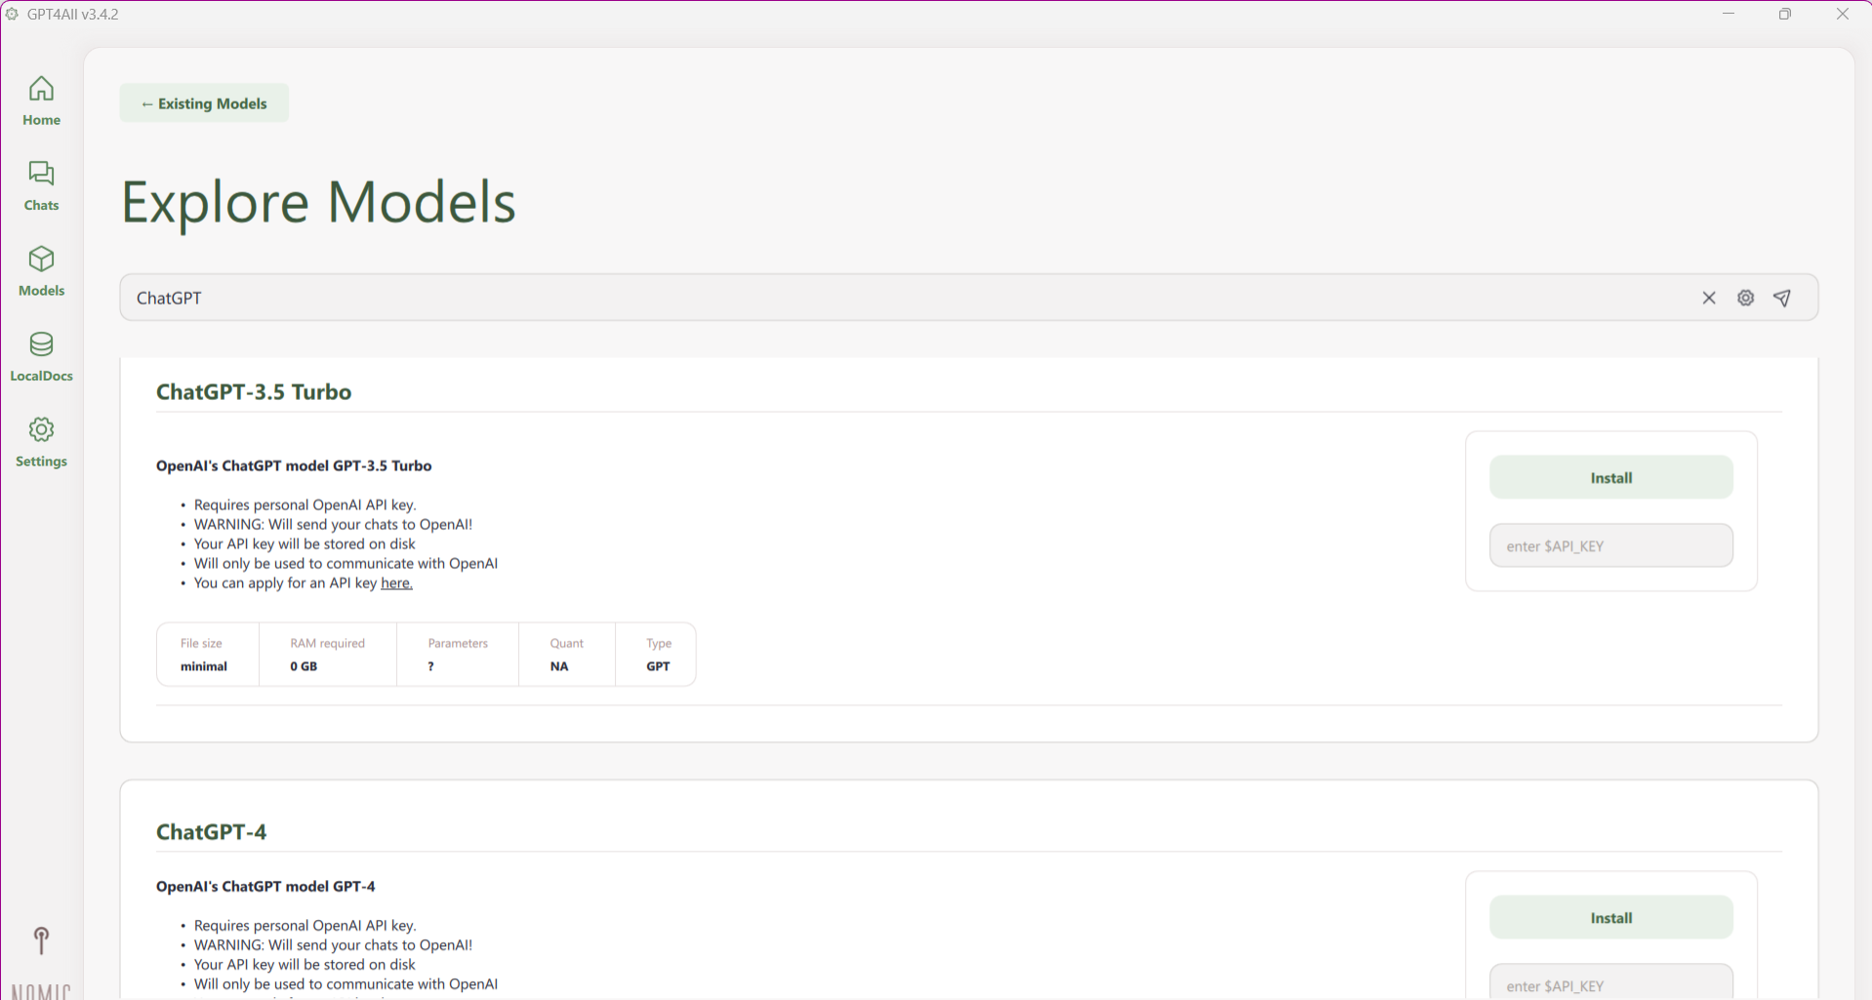

Slide 9
LMStudio
LMStudio is a toolkit for deploying and hosting LLMs on local machines.
Easy-to-use interface for managing models and resources.
Focuses on making LLM deployment accessible for non-experts.
Example Use: Host multiple models locally for research purposes.
Notes:
Non Coders - low coders

Slide 10
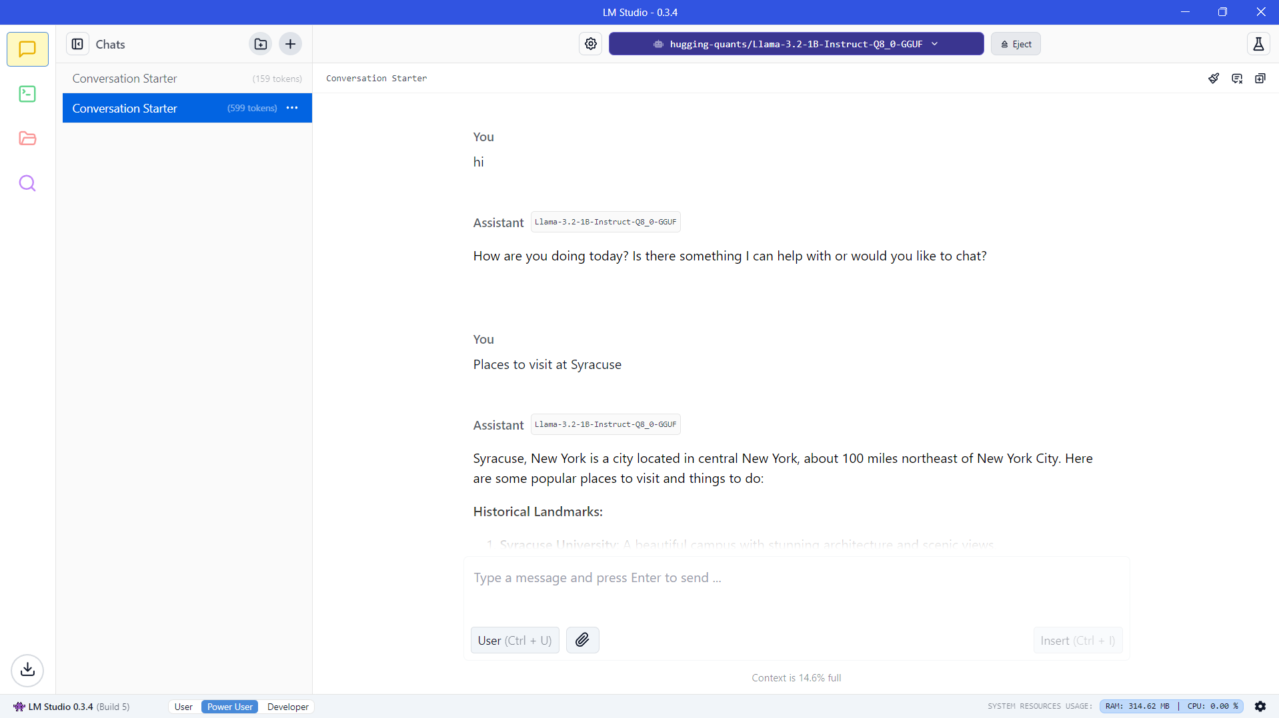
Download from : https://lmstudio.ai

Slide 11
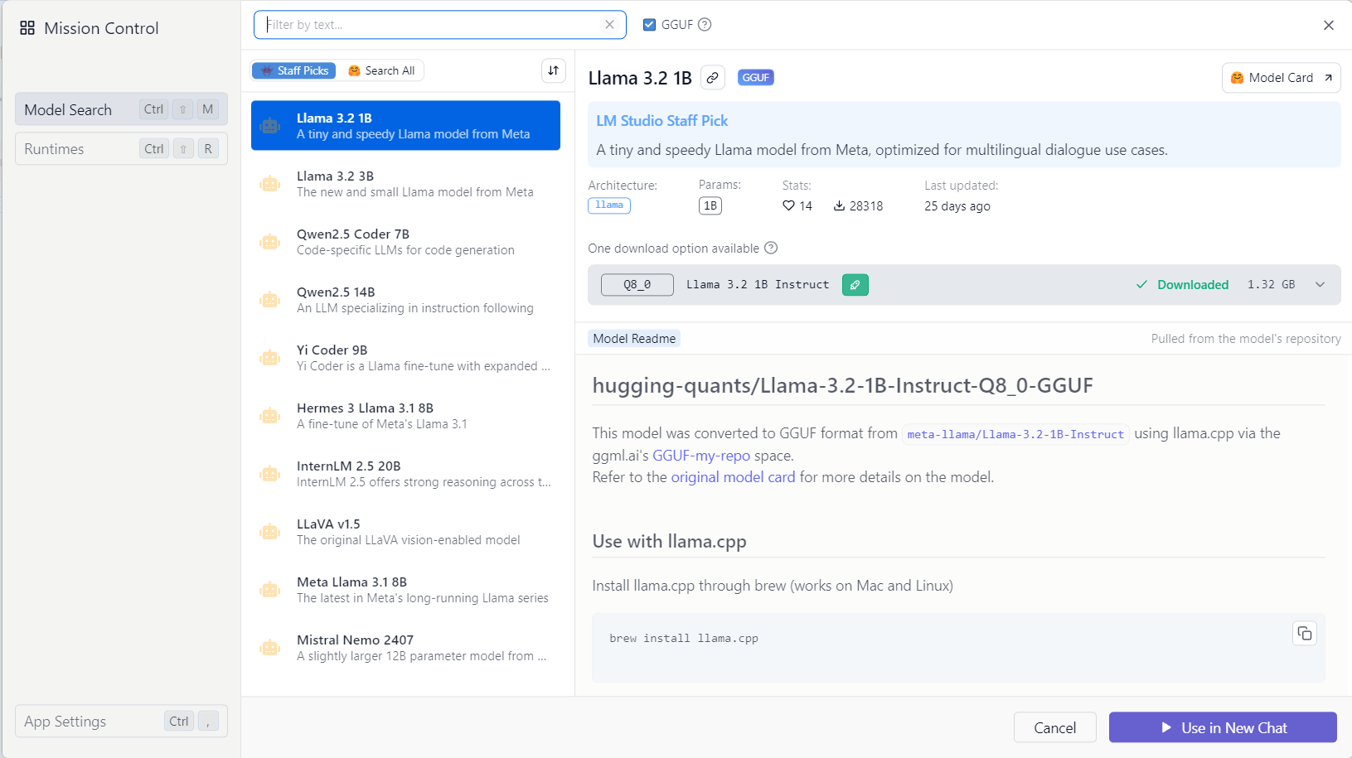

Slide 12
H2O GPT
H2O GPT helps users build AI-driven apps with LLMs.
Scalable, open-source solution for deploying LLMs locally or in the cloud.
Focus on enterprise applications with a full-stack AI approach.
Example Use: Develop custom LLM-powered apps for businesses.
https://github.com/h2oai/h2ogpt
Notes:
Enterprise Business

Slide 13
OLLAMA
Ollama offers streamlined local deployment for large models.
Optimized for fine-tuning models and controlling resource use.
Provides an intuitive platform for AI experimentation.
Example Use: Local customization of LLMs with low latency.
Notes:
Developers Individuals

Slide 14
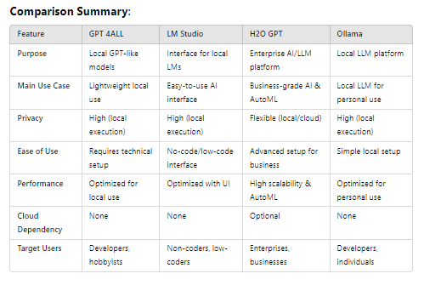
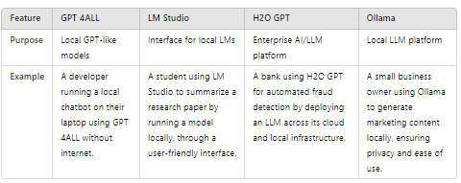

Slide 15
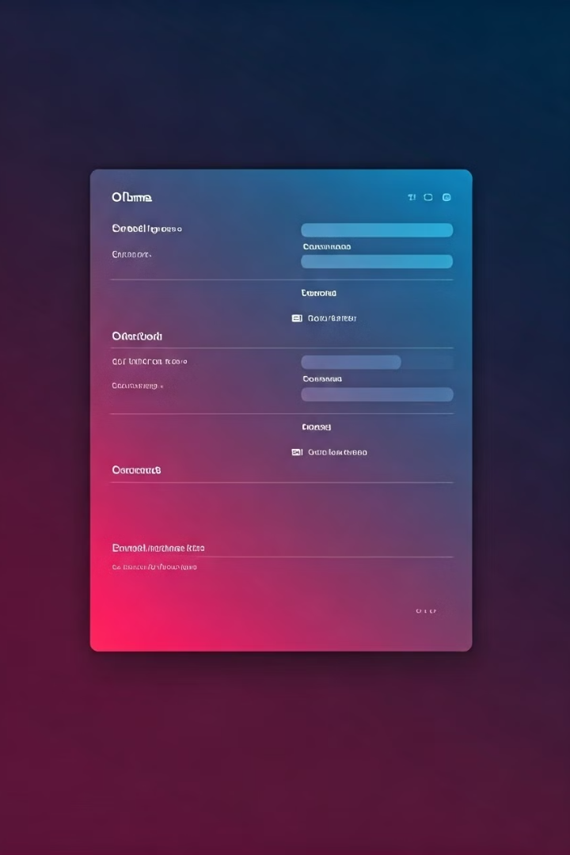
Step-by-Step Guide with Ollama
1
Install Ollama: https://ollama.com
Download and install easily.
2
Select a Model
Choose "llama2" or similar.
3
Run the Command
Type "ollama run llama2".
4
Interact with Model
Begin asking questions!

Slide 16
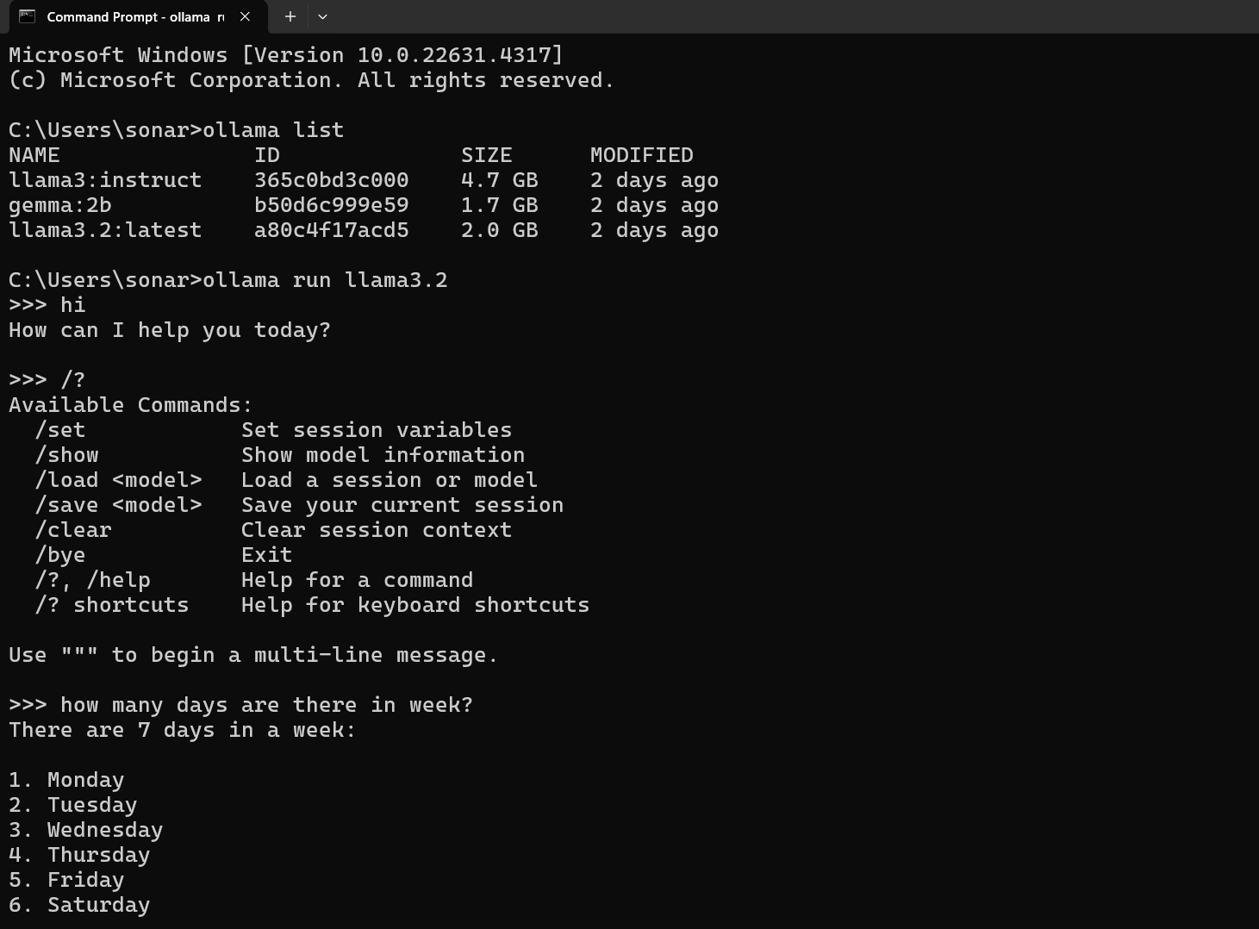

Slide 17
API END POINTS
http://localhost:11434 : Check if Ollama is running
http://localhost:11434/api/tags : Provides Models details
http://localhost:11434/api/generate : Endpoint to interact with model

Slide 18
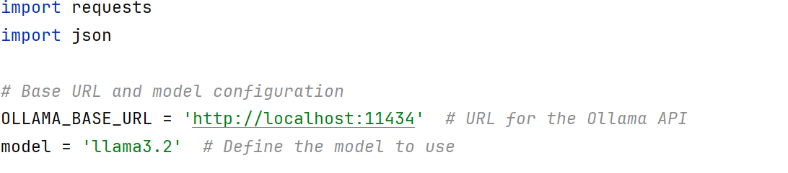
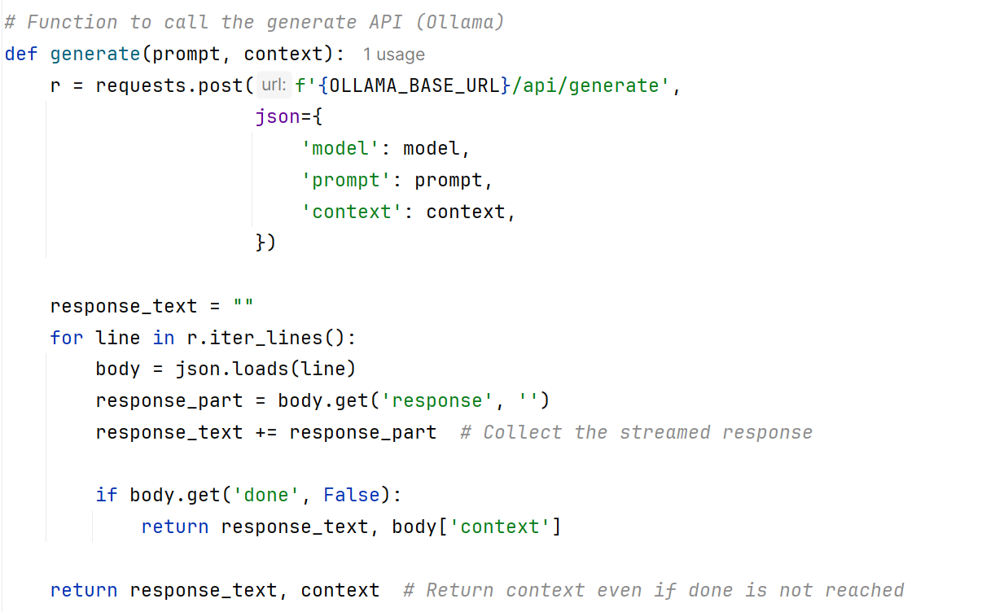

Slide 19

Key Benefits of Local LLMs
Cost Savings
Reduce cloud computing costs.
Enhanced Privacy
Keep your data secure locally.
Offline Access
Use LLMs anywhere, anytime.
Faster Experimentation
Iterate quickly, no cloud delays.
Notes:
Cost Savings:
Running LLMs locally can significantly reduce your cloud computing costs. Instead of paying for every API call, you only need to invest in the hardware and software required to run the model on your own machine.
This is particularly beneficial for startups with limited budgets, as it allows them to allocate resources to other critical areas of their business.
Enhanced Privacy:
With local LLMs, you can keep your data secure and confidential.
Since the model runs on your own hardware, there's no need to send sensitive information to the cloud, giving you complete control over your data privacy.
Imagine a healthcare company processing patient records – by using local LLMs, they can ensure that this sensitive data never leaves their premises.
Offline Access:
One of the great things about local LLMs is that you can use them anywhere, anytime, even without an internet connection.
This is especially useful for applications that require uninterrupted access or when working in areas with limited connectivity.
For instance, if you're a researcher working on a field project in a remote location, having offline access to LLMs can ensure that your work continues uninterrupted.
Faster Experimentation:
Running LLMs locally allows you to iterate and experiment quickly.
You don't have to wait for cloud resources or deal with network latency, enabling you to test ideas and prototypes more efficiently.
This is a game-changer for developers and data scientists who want to rapidly iterate on their models and get results faster.

Slide 20
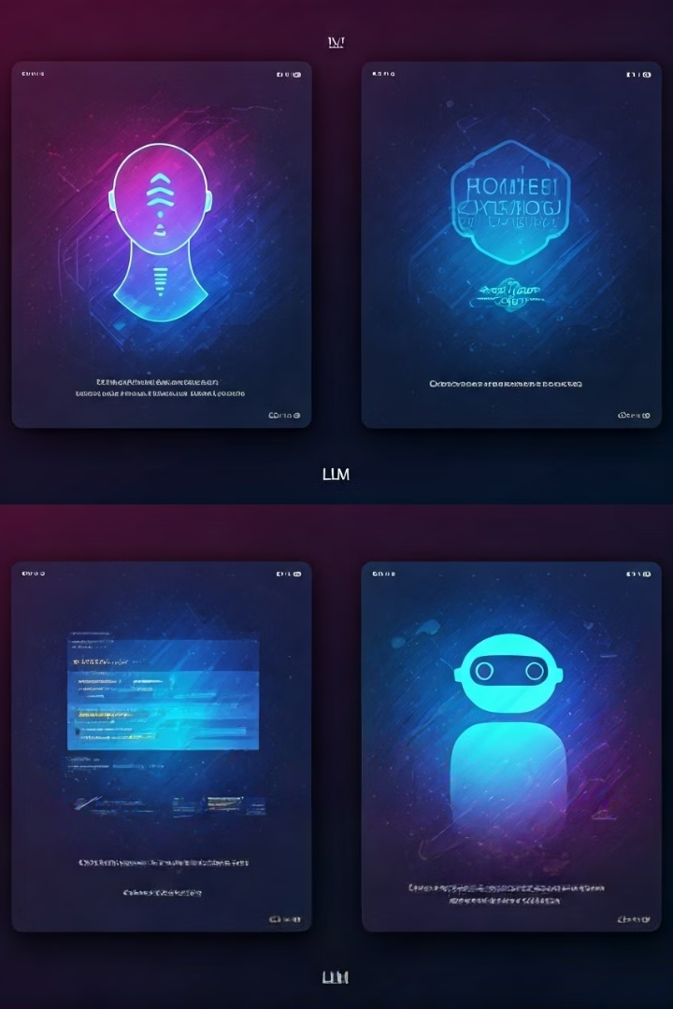
Local LLM Applications
AI Assistants
Personalized, always-on help.
Offline Translation
Seamless global communication.
Local Code Generation
Fast, efficient development.
Custom Chatbots
Specialized domain expertise.
Notes:
AI Assistants:
With local LLMs, you can create personalized, always-on AI assistants that cater to your specific needs.
For example, you could develop a virtual assistant that helps you manage your schedule, answer questions, or even provide domain-specific advice.
Offline Translation:
Local LLMs enable seamless global communication by providing offline translation capabilities.
Imagine being able to translate between languages on-the-go, without relying on an internet connection.
This could be a game-changer for international travelers or businesses operating in multilingual environments.
Local Code Generation:
LLMs can also be used to generate code snippets or even entire functions based on natural language descriptions.
By running these models locally, developers can streamline their workflow and create code more efficiently without the need for cloud-based services.
Custom Chatbots:
Local LLMs allow you to build specialized chatbots with domain-specific knowledge.
For instance, a company could create a chatbot that provides technical support or answers frequently asked questions about their products, all while keeping the data in-house and ensuring quick response times.

Slide 21



Performance and Limitations
Performance
1
May be slower.
Updates
2
Regular maintenance.
Models
3
Limited options.
Consider these factors.
Notes:
Performance:
It's important to note that local LLMs may be slower compared to their cloud-based counterparts, especially if you're running them on less powerful hardware.
For example, if you're running a large LLM on a machine with a low-end CPU and limited RAM, you may experience slower response times compared to running the same model on a high-performance cloud server.
However, this trade-off is often acceptable considering the benefits of cost savings, privacy, and offline access.
Updates:
When running LLMs locally, you'll need to perform regular maintenance and updates to keep the models up-to-date with the latest improvements.
This requires some technical expertise and effort, but it also gives you more control over the model's performance and functionality.
For instance, if a new version of the LLM is released with improved performance or additional features, you'll need to manually update the model on your local machine to take advantage of these enhancements.
Models:
While there are several open-source LLMs available for local deployment, the selection may be more limited compared to the wide range of models offered by cloud providers.
For example, while you might find a suitable open-source LLM for general-purpose tasks like text generation or question-answering, you may have a harder time finding specialized models for niche domains or specific use cases, which are more readily available through cloud providers.
However, as the local LLM ecosystem grows, we can expect to see more diverse and specialized models become available for local use.

Slide 22
Questions
1
2
3
Popular Local LLM Platforms
Cloud vs Local
Local Advantages
Name a few
Core differences.
4
5
Can you access the LLMs if
there is no internet?
Disadvantages of
Locally-run LLMs

Slide 23
Answers
1
2
Popular Local LLM Platforms
Cloud vs Local
GPT4All
Ollama
LMStudio
H2O GPT
Cloud
Powerful
Updated
Costly
Privacy issues
Internet required
Local
Cost-effective
Not so many Privacy issues
Offline access

Slide 24
Answers
4
5
Can you access the LLMs if
there is no internet?
Disadvantages of
Locally-run LLMs:
Potentially slower
Regular maintenance
Limited model selection
YES

Slide 25




Q&A Session
Open Forum
Ask anything!
Interactive Discussion
Share your insights.
Clear Explanations
Get answers.
Knowledge Sharing
Learn together.

